Slide 1
RefleXGen: The unexamined code is not worth using
Bin Wang, Hui Li, AoFan Liu, BoTao Yang, Ao Yang, YiLu Zhong, Weixiang Huang, Runhuai Huang, Weimin Zeng, Yanping Zhang

Slide 2


RefleXGen: The unexamined code is not worth using
Bin Wang, Hui Li, AoFan Liu, BoTao Yang, Ao Yang, YiLu Zhong, Weixiang Huang, Runhuai Huang, Weimin Zeng, Yanping Zhang

Slide 3
Research Background
RefleXGen: The Unexamined Code Is Not Worth Using
Bin Wang, Hui Li, AoFan Liu, BoTao Yang, Ao Yang, YiLu Zhong, Weixiang Huang, Runhuai Huang, Weimin Zeng, Yanping Zhang
Problem | LLM-generated code often contains security vulnerabilities due to unsafe training data.
Existing Solution | Fine-tuning LLMs or creating secure datasets → Resource-intensive. Limited focus on iterative self-improvement.
RefleXGen | Integrates ​RAG (Retrieval-Augmented Generation) with ​self-reflection mechanisms.
Advantage | Iteratively optimizes code security without fine-tuning.
Key Terms | Code Security, LLMs, RAG, Self-Reflection, CodeQL
Enhancing Code Security via RAG and Self-Reflection
Affiliation: Peking University

Slide 4
Related Work
RefleXGen: The Unexamined Code Is Not Worth Using
Bin Wang, Hui Li, AoFan Liu, BoTao Yang, Ao Yang, YiLu Zhong, Weixiang Huang, Runhuai Huang, Weimin Zeng, Yanping Zhang
Related LLM Research
​Traditional Rule-Based Methods
Transformer-Based LLMs
Relied on heuristic rules or expert systems to map requirements to code.
Inflexible and unscalable due to rigid rule sets. Limited to narrow domains (e.g., template-based code generation).
Codex
CodeGen
CodeT5
Early Deep Learning Approaches
Code Generation Security
Trained on code corpora to predict code sequences (e.g., [2], [3]). ​Advancements: Enabled mapping natural language descriptions to code snippets.
​Secure Training Practices:
​StarCoder [5] and ​CodeLlama [17]:
Filtered training data to exclude vulnerable code snippets.
Added security-focused pretraining objectives.
​Limitation:
Security guarantees depend on data quality, which is hard to ensure at scale.
However,these are not so effective!
Limitaion
Ceres is located in the main asteroid belt
SATURN
Saturn is a gas giant and has several rings

Slide 5
RefleXGen’s Innovation
Core Idea:
​Self-Reflection: Guides LLMs to iteratively critique and repair code.
RAG Integration: Dynamically retrieves secure coding practices and historical fixes.
Related Work
There are various code generation models based on the Transformer architecture, such as Codex, CodeGen, CodeT5, etc., as well as research on evaluating and improving code security, such as StarCoder, CodeLlama, SafeCoder, etc.
RefleGen!
This template was created by Slidesgo

Slide 6
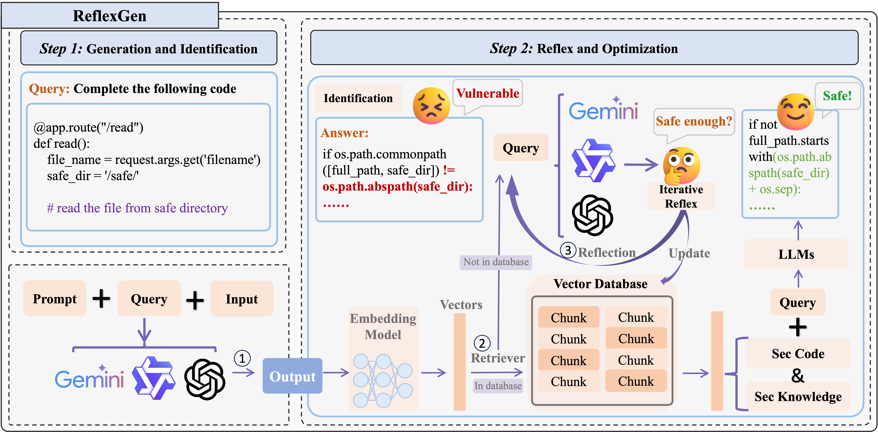
Methodology
RefleXGen: The Unexamined Code Is Not Worth Using
Bin Wang, Hui Li, AoFan Liu, BoTao Yang, Ao Yang, YiLu Zhong, Weixiang Huang, Runhuai Huang, Weimin Zeng, Yanping Zhang
Architecture
Method
RefleXGen combines ​self-refinement and ​RAG to improve LLM-generated code security without model fine-tuning. Its workflow follows a two-phase process:
​Phase 1: Generate initial code from user requirements.
​Phase 2: Iteratively optimize code through security-focused reflection.
Validated secure code updates a dynamic safety knowledge base.
Future tasks leverage accumulated insights for enhanced security.
Key advantages: ​No training overhead, ​adaptive knowledge integration, and ​broad model compatibility.
Fig 1. The diagram presents the structured workflow of the ReflexGen methodology, segmented into three critical stages: ① Initial Code Generation, ②Knowledge-Driven Security Feedback, and ③ Defect Fixing and Knowledge Integration. The process initiates with the generation of initial code. If, uponintrospection, the model discerns security deficiencies in the code, it activates Step 2. This stage entails rigorous reflection and optimization to addressand rectify vulnerabilities. Subsequently, through a cyclical process of secure code production, insights derived from this reflective phase are systematicallyintegrated into the security knowledge base, thus promoting continual enhancements

Slide 7



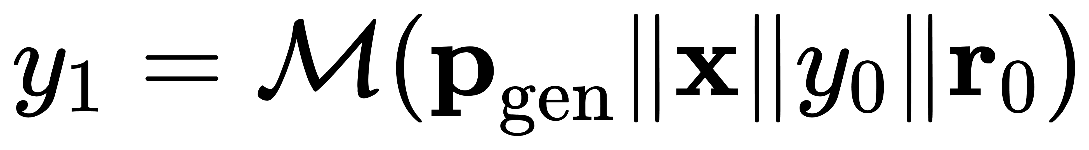
Methodology
Detailed Steps
Step 1：Initial Code Gen
If the RAG query fails to provide sufficient security knowledge, the sys- tem proceeds to a thorough reflection and iterative repair pro- cess, as outlined in Equation.
In the stage, the systemis provided with an input code snippet x, a prompt pgen,and accesses the model M. The code generation model thenproduces the initial output
Once the code fulfills all specified safety requirements, the refined se- curity knowledge and the enhanced code are systematically organized and stored within the secure knowledge base (sec. RAG). Subsequently, the system reinitiates the first step to verify the output, ensuring that the improvements effectively address the initial shortcomings.
Step 2：Reflection and Optimization
In this step, the system initially employs its model to introspect and determine the presence of any potential defects in the output. Should the output be defect-free, the system will proceed to display the results directly. However, if defects are identified, the system transitions into a phase of reflective iteration.

Slide 8
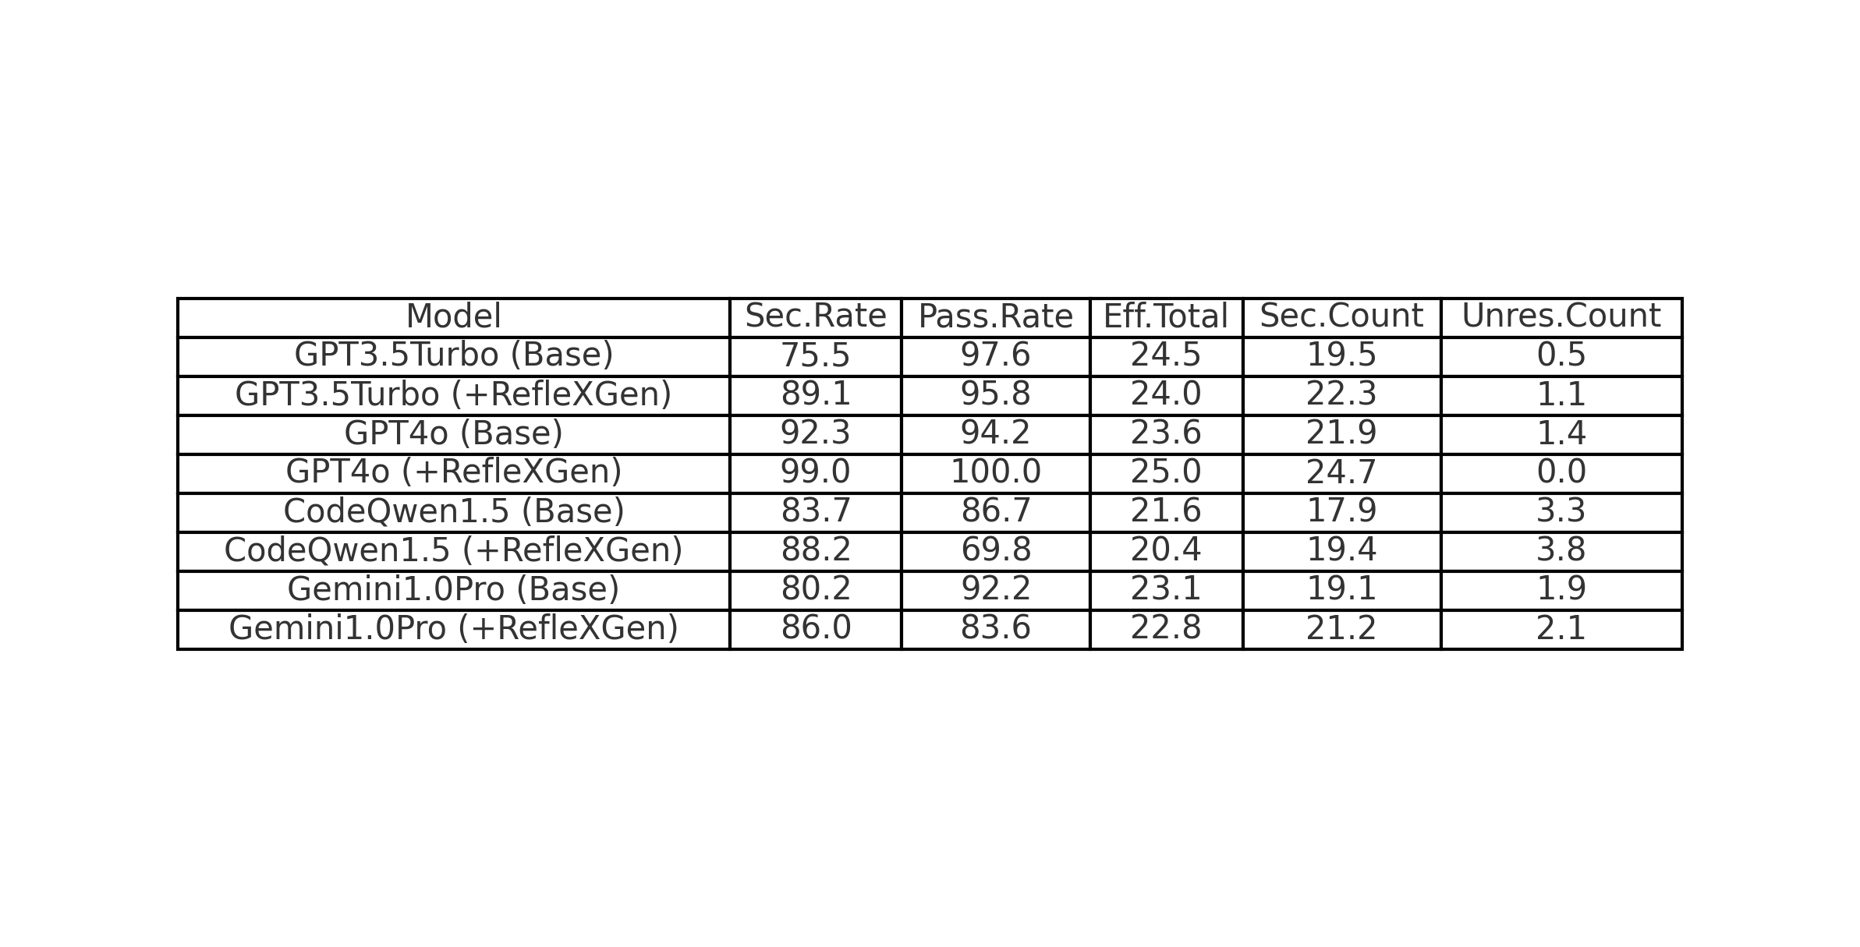
Experiment
Experiment Settings
Model Selection
Dataset
Due to the limitations of smaller open-source and specialized code-completion models in dialogue and reflective knowledge assessment, we selected more comprehensive mainstream models for our evaluation. These include prominent commercial models like OpenAI's GPT-3.5 Turbo and GPT-4, Google's Gemini, and the open-source model Qwen. These models exhibit advanced code generation capabilities and excel in managing dialogues, aligning well with our testing criteria.
To evaluate RefleXGen's improvements in code generation security and reliability, we selected challenging scenarios from the most impactful Common Weakness Enumerations (CWEs). We used a dataset validated by He et al., featuring nine scenarios from MITRE's top 25 most dangerous software vulnerabilities.

Slide 9
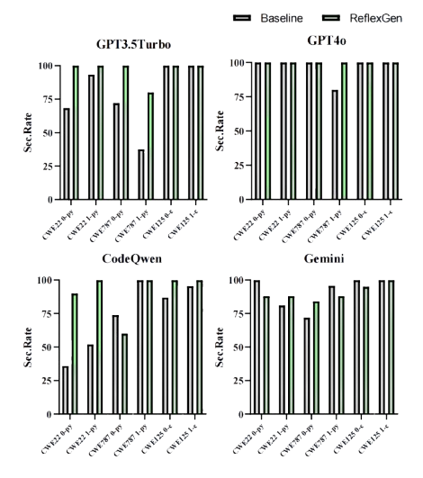
Experiment
Experiment Result
To ensure a fair comparison, we initially set the RAG content to empty, allowing RefleXGen to progressively generate content during testing.
We tracked several metrics: Sec. Rate , Pass Rate, Eff. Total,Sec. Count,Unres. Count. To obtain reliable data, we conducted five repeated experiments for each model. CodeQL was utilized to perform security analysis and assessment.
In each experiment, every scenario was subjected to 25 task generations to average the results, ensuring an objective assessment of each model's generative capabilities.

Slide 10
Conclusion
RefleXGen: The Unexamined Code Is Not Worth Using
Bin Wang, Hui Li, AoFan Liu, BoTao Yang, Ao Yang, YiLu Zhong, Weixiang Huang, Runhuai Huang, Weimin Zeng, Yanping Zhang
What we have done…
Not done…
In this work, we have introduced RefleXGen, an innovative method that significantly enhances the security of code generated by large language models without the need for model fine-tuning or the creation of specialized security datasets.
Universally applicable to all code generation models and operating independently of external enhancements, RefleXGen leverages the models' inherent reflective processes to accumulate security knowledge. By building a dynamic knowledge base, it optimizes prompts for subsequent code generation cycles.
Experimental results demonstrate that RefleXGen substantially improves code generation security across various models, including GPT-3.5, GPT-4, CodeQwen, and Gemini, with particularly notable enhancements in models possessing stronger overall capabilities. This advancement underscores the potential of self-reflective mechanisms in AI models to autonomously improve code security, paving the way for future research in secure code generation without extensive resource investment.
Optimize real-time performance: reduce the number of iterations or introduce parallelization strategies.​
Expand language support: adapt security rules of languages ​​such as Rust and JavaScript.​
Dynamic analysis integration: integrate fuzzing or symbolic execution.​
Pre-trained security knowledge base: provide a pre-built security code base to accelerate cold start.​
Model capability enhancement: design lightweight fine-tuning or prompt engineering techniques for security tasks.

Slide 11
RefleXGen: The unexamined code is not worth using
Reference
[1] Xin-Ye Li, Jiang-Tian Xue, Zheng Xie, and Ming Li,“Think outside the code: Brainstorming boosts largelanguage models in code generation,” arXiv preprintarXiv:2305.10679, 2023.
[2] Wang Ling, Edward Grefenstette, Karl Moritz Her-mann, Tom´aˇs Koˇcisk`y, Andrew Senior, Fumin Wang,and Phil Blunsom, “Latent predictor networks for codegeneration,” arXiv preprint arXiv:1603.06744, 2016.
[3] Veselin Raychev, Pavol Bielik, and Martin Vechev,“Probabilistic model for code with decision trees,” ACMSIGPLAN Notices, vol. 51, no. 10, pp. 731–747, 2016.
[4] OpenAI, “Openai codex,” 2021, Accessed: 2024-08-18.
[5] Anton Lozhkov, Raymond Li, Loubna Ben Allal, Fed-erico Cassano, Joel Lamy-Poirier, Nouamane Tazi,Ao Tang, Dmytro Pykhtar, Jiawei Liu, Yuxiang Wei,et al., “Starcoder 2 and the stack v2: The next gener-ation,” arXiv preprint arXiv:2402.19173, 2024.
[6] Aakanksha Chowdhery, Sharan Narang, Jacob Devlin,Maarten Bosma, Gaurav Mishra, Adam Roberts, PaulBarham, Hyung Won Chung, Charles Sutton, SebastianGehrmann, et al., “Palm: Scaling language modelingwith pathways,” Journal of Machine Learning Research,vol. 24, no. 240, pp. 1–113, 2023.
[7] Dongling Xiao, Han Zhang, Yukun Li, Yu Sun, HaoTian, Hua Wu, and Haifeng Wang, “Ernie-gen: Anenhanced multi-flow pre-training and fine-tuning frame-work for natural language generation,” arXiv preprintarXiv:2001.11314, 2020.
[8] Yue Wang, Weishi Wang, Shafiq Joty, and Steven CHHoi, “Codet5: Identifier-aware unified pre-trainedencoder-decoder models for code understanding andgeneration,” arXiv preprint arXiv:2109.00859, 2021.
[9] Yujia Li, David Choi, Junyoung Chung, Nate Kush-man, Julian Schrittwieser, R´emi Leblond, Tom Eccles,James Keeling, Felix Gimeno, Agustin Dal Lago, et al.,“Competition-level code generation with alphacode,”Science, vol. 378, no. 6624, pp. 1092–1097, 2022.
[10] Priyan Vaithilingam, Tianyi Zhang, and Elena L Glass-man, “Expectation vs. experience: Evaluating the us-ability of code generation tools powered by large lan-guage models,” in Chi conference on human factors incomputing systems extended abstracts, 2022, pp. 1–7.
[11] Jingxuan He and Martin Vechev, “Large language mod-els for code: Security hardening and adversarial testing,”in Proceedings of the 2023 ACM SIGSAC Conferenceon Computer and Communications Security, 2023, pp.1865–1879.
[12] Hammond Pearce, Baleegh Ahmad, Benjamin Tan,Brendan Dolan-Gavitt, and Ramesh Karri, “Asleep atthe keyboard? assessing the security of github copilot’scode contributions,” in 2022 IEEE Symposium on Secu-rity and Privacy (SP). IEEE, 2022, pp. 754–768.
[13] Cordell Green, “Application of theorem proving toproblem solving,” in Readings in Artificial Intelligence,pp. 202–222. Elsevier, 1981.
[14] Zeyu Sun, Qihao Zhu, Yingfei Xiong, Yican Sun, LiliMou, and Lu Zhang, “Treegen: A tree-based trans-former architecture for code generation,” in Proceedingsof the AAAI conference on artificial intelligence, 2020,vol. 34, pp. 8984–8991.
[15] Erik Nijkamp, Bo Pang, Hiroaki Hayashi, Lifu Tu, HuanWang, Yingbo Zhou, Silvio Savarese, and CaimingXiong, “Codegen: An open large language model forcode with multi-turn program synthesis,” arXiv preprintarXiv:2203.13474, 2022.
[16] Jeevana Priya Inala, Chenglong Wang, Mei Yang,Andres Codas, Mark Encarnaci´on, Shuvendu Lahiri,Madanlal Musuvathi, and Jianfeng Gao, “Fault-awareneural code rankers,” Advances in Neural InformationProcessing Systems, vol. 35, pp. 13419–13432, 2022.
This template was created by Slidesgo

